Slide 1

Chapter 14
Inheritance
Copyright © 2017 Pearson Education, Ltd. All rights reserved.

Slide 2
Learning Objectives
Inheritance Basics
Derived classes, with constructors
protected: qualifier
Redefining member functions
Non-inherited functions
Programming with Inheritance
Assignment operators and copy constructors
Destructors in derived classes
Multiple inheritance

Slide 3
Reuse
Composition
Simply create objects of existing class inside the new class
The new class is composed of objects of existing classes
Inheritance
Subtler
Create a new class as a type of an existing class
Add code to the existing class
Without modifying the existing class

Slide 4
"Has a" vs. "Is a" Relationships
Composition
Considered a "Has a" class relationship
A class contains objects of another class as it’s member data
e.g., Automobile has four wheels and a engine
A network has nodes and links
Inheritance
Considered an "Is a" class relationship
e.g., An HourlyEmployee "is a" Employee
A Convertible "is a" Automobile
Notes:
Network contains node and links
Protocols can be FaceRouting, GreedyRouting, …

Slide 5
Introduction to Inheritance
Object-oriented programming
Powerful programming technique
Provides abstraction dimension called inheritance
General form of class is defined
Specialized versions then inherit properties of general class
And add to it/modify it’s functionality for it’s appropriate use

Slide 6
Inheritance Basics
New class inherited from another existing class
Base class
"General" class from which others derive
Derived class
New class
Automatically has base class’s:
Member variables
Member functions
Can then add additional member functions and variables

Slide 7
Derived Classes
Consider example: Class of "Employees"
Composed of:
Salaried employees
Hourly employees
Each is "subset" of employees
Another might be those paid fixed wage each month or week
Notes:
Base class 員工
Derived class 月薪員工、時薪員工
梅西一個禮拜的薪水 50 多萬 歐元

Slide 8
Derived Classes
Don’t "need" type of generic "employee"
Since no one’s just an "employee"
General concept of employee helpful!
All have names
All have social security numbers
Associated functions for these "basics" are same among all employees
So "general" class can contain all these "things" about employees

Slide 9
Employee Class
Many members of "employee" class apply to all types of employees
Accessor functions
Mutator functions
Most data items:
SSN
Name
Pay
We won’t have "objects" of this class, however
Notes:
基本上，你不會用到這個 class 來產生 object

Slide 10
Employee Class
Consider printCheck() function:
Will always be "redefined" in derived classes
So different employee types can have different checks
Makes no sense really for "undifferentiated" employee
So function printCheck() in Employee class says just that
Error message stating "printCheck called for undifferentiated employee!! Aborting…"

Slide 11
Deriving from Employee Class
Derived classes from Employee class:
Automatically have all member variables
Automatically have all member functions
Derived class said to "inherit" members from base class
Can then redefine existing members and/or add new members

Slide 12
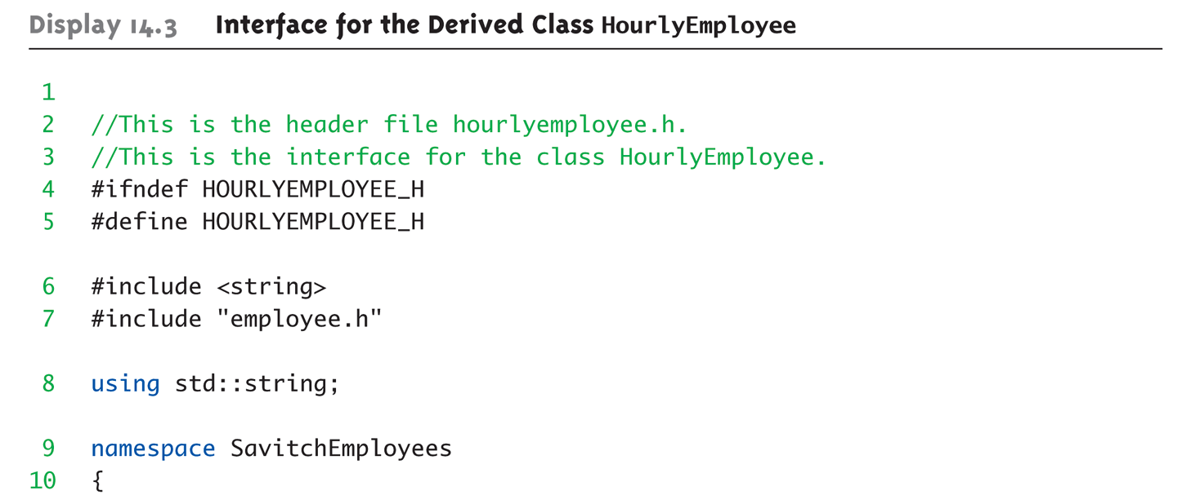
Display 14.3 Interface for the Derived Class HourlyEmployee (1 of 2)

Slide 13
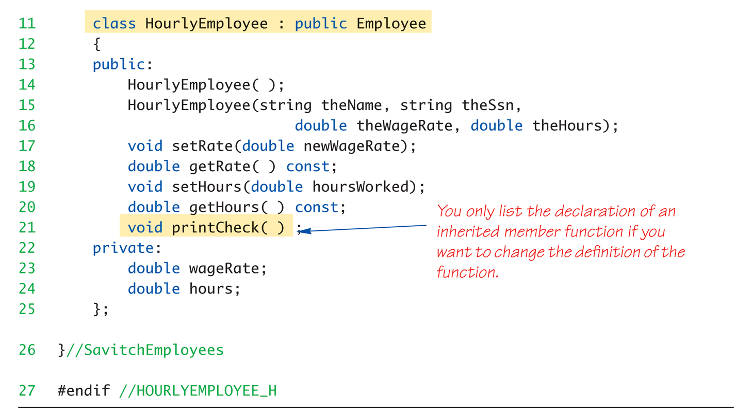
Display 14.3 Interface for the Derived Class HourlyEmployee (2 of 2)
Notes:
如果你要修改或新增，才需要列出這些 function 和 variable

Slide 14
HourlyEmployee Class Interface
Note definition begins same as any other
#ifndef structure
Includes required libraries
Also includes employee.h!
And, the heading: class HourlyEmployee : public Employee { …
Specifies "publicly inherited" from Employee class
Notes:
Public 現在應該很難理解，不過，你可以先知道這樣寫的意思是繼承 Employee class，可以先想像成，如果 Employee 裡面的東西，原本是 public，那在我這裡也是 public，如果是 private，則在我這裡也是 private

Slide 15
HourlyEmployee Class Additions
Derived class interface only lists new or "to be redefined" members
Since all others inherited are already defined
i.e.: "all" employees have ssn, name, etc.
HourlyEmployee adds:
Constructors
Member variables: wageRate, hours
Member functions: setRate(), getRate(), setHours(), getHours()
Notes:
新增或修改

Slide 16
HourlyEmployee Class Redefinitions
HourlyEmployee redefines:
printCheck() member function
This ”redefines" the printCheck() function implementation from Employee class
It’s definition must be in HourlyEmployee class’s implementation
As do other member functions declared in HourlyEmployee’s interface
New and "to be redefined"
Notes:
要修改就要放在 interface，且要有實作，看起來跟新增新的 function 很像

Slide 17
Inheritance Terminology
Common to simulate family relationships
Parent class
Refers to base class
Child class
Refers to derived class
Ancestor class
Class that’s a parent of a parent …
Descendant class
Opposite of ancestor

Slide 18
Constructors in Derived Classes
Base class constructors are NOT inherited in derived classes!
But they can be invoked within derived class constructor
Which is all we need!
Base class constructor must initialize all base class member variables
Those inherited by derived class
So derived class constructor simply calls it
"First" thing derived class constructor does

Slide 19
Derived Class Constructor Example
Consider syntax for HourlyEmployee constructor: HourlyEmployee::HourlyEmployee(string theName, string theNumber, double theWageRate, double theHours) : Employee(theName, theNumber), wageRate(theWageRate), hours(theHours) { //Deliberately empty }
Portion after : is "initialization section"
Includes invocation of Employee constructor

Slide 20
Another HourlyEmployee Constructor
A second constructor: HourlyEmployee::HourlyEmployee() : Employee(), wageRate(0), hours(0) { //Deliberately empty }
Default version of base class constructor is called (no arguments)
Should always invoke one of the base class’s constructors

Slide 21
Constructor: No Base Class Call
Derived class constructor should always invoke one of the base class’s constructors
If you do not:
Default base class constructor automatically called
Equivalent constructor definition: HourlyEmployee::HourlyEmployee() : wageRate(0), hours(0) { }
With Employee() omitted, the default constructor of Employee will be invoked
If it does not exist, an error occurs
Notes:
若是default constructor不存在，則 error

Slide 22
Pitfall: Base Class Private Data
Derived class "inherits" private member variables
But still cannot directly access them
Not even through derived class member functions!
Private member variables can ONLY be accessed "by name" in member functions of the class they’re defined in
Employee’s “name” can only be changed by Employee’s “setName ()”

Slide 23
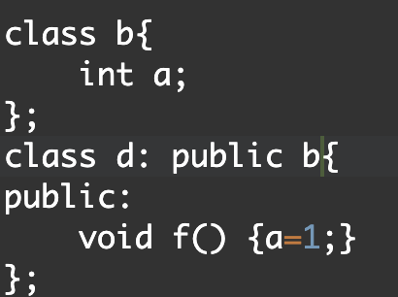
Pitfall: Base Class Private Data
Derived class "inherits" private member variables
But still cannot directly access them
Not even through derived class member functions!
Private member variables can ONLY be accessed "by name" in member functions of the class they’re defined in
Employee’s “name” can only be changed by Employee’s “setName ()”

Slide 24
Pitfall: Base Class Private Member Functions
Same holds for base class member functions
Cannot be accessed outside interface and implementation of base class
Not even in derived class member function definitions
Notes:
一樣的概念，private member function 也不能被 child class 使用

Slide 25
Pitfall: Base Class Private Member Functions Impact
Larger impact here vs. member variables
Member variables can be accessed indirectly via accessor or mutator member functions
Member functions simply not available
This is "reasonable"
Private member functions should be simply "helper" functions
Should be used only in class they’re defined

Slide 27
The protected: Qualifier
New classification of class members
Allows access "by name" in derived class
But nowhere else
Still no access "by name" in other classes
In class it’s defined → acts like private
Considered "protected" in derived class
To allow future derivations
Many feel this "violates" information hiding

Slide 28
Redefinition of Member Functions
Recall interface of derived class:
Contains declarations for new member functions
Also contains declarations for inherited member functions to be changed
Inherited member functions NOT declared:
Automatically inherited unchanged
Implementation of derived class will:
Define new member functions
Redefine inherited functions as declared

Slide 29
Redefining vs. Overloading
Very different!
Redefining in derived class:
SAME parameter list
Essentially "re-writes" same function
Name Hidden: all the other versions are automatically hidden in the new class
Overloading:
Different parameter list
Defined "new" function that takes different parameters
Overloaded functions must have different signatures

Slide 30
A Function’s Signature
Recall definition of a "signature":
Function’s name
Sequence of types in parameter list
Including order, number, types
Signature does NOT include:
Return type
const keyword
&

Slide 31
Accessing Redefined Base Function
When redefined in derived class, base class’s definition not "lost"
Can specify it’s use: Employee JaneE; HourlyEmployee SallyH; JaneE.printCheck(); → calls Employee’s printCheck function SallyH.printCheck(); → calls HourlyEmployee printCheck function SallyH.Employee::printCheck(); → Calls Employee’s printCheck function!
Not typical here, but useful sometimes

Slide 32
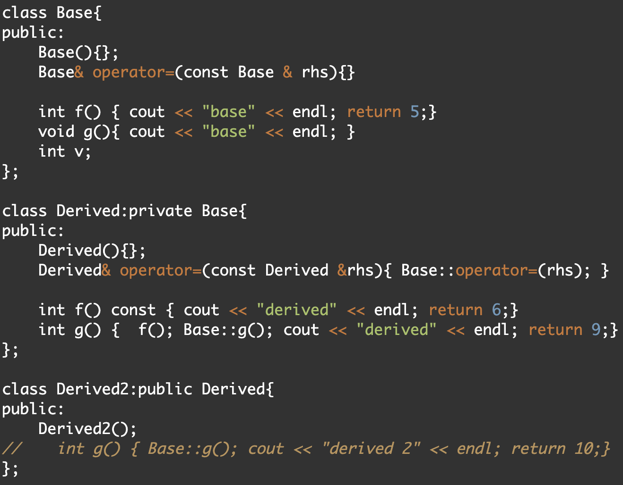
Name Hiding
Notes:
看 derived 裡的 g() 裡的 f()，請問他會是哪一個 f()?
後面會有更延伸的多型

Slide 34
Functions Not Inherited
All "normal" functions in base class are inherited in derived class
Exceptions:
Constructors (we’ve seen)
Destructors
Copy constructor
But if not defined, generates "default" one
Recall need to define one for pointers!
Assignment operator
If not defined → default (e.g., =)

Slide 35
Assignment Operators and Copy Constructors
Recall: overloaded assignment operators and copy constructors in the base class NOT inherited
But can be used in derived class definitions
Typically MUST be used!
Similar to how derived class constructor invokes base class constructor

Slide 36
Assignment Operator Example
Given "Derived" is derived from "Base": Derived& Derived::operator =(const Derived & rightSide) { Base::operator =(rightSide); … }
Notice code line
Calls assignment operator from base class
This takes care of all inherited member variables
Would then set new variables from derived class…

Slide 37
Copy Constructor Example
Consider: Derived::Derived(const Derived& Object) : Base(Object), … {…}
After : is invocation of base copy constructor
Sets inherited member variables of derived class object being created
Note Object is of type Derived; but it’s also of type Base, so argument is valid

Slide 38
Destructors in Derived Classes
If base class destructor functions correctly
Easy to write derived class destructor
When derived class destructor is invoked:
Automatically calls base class destructor!
So no need for explicit call
So derived class destructors need only be concerned with derived class variables
And any data they "point" to
Base class destructor handles inherited data automatically

Slide 39
Destructor Calling Order
Consider: class B derives from class A class C derives from class B A ← B ← C
When object of class C goes out of scope:
Class C destructor called 1st
Then class B destructor called
Finally class A destructor is called
Opposite of how constructors are called

Slide 40
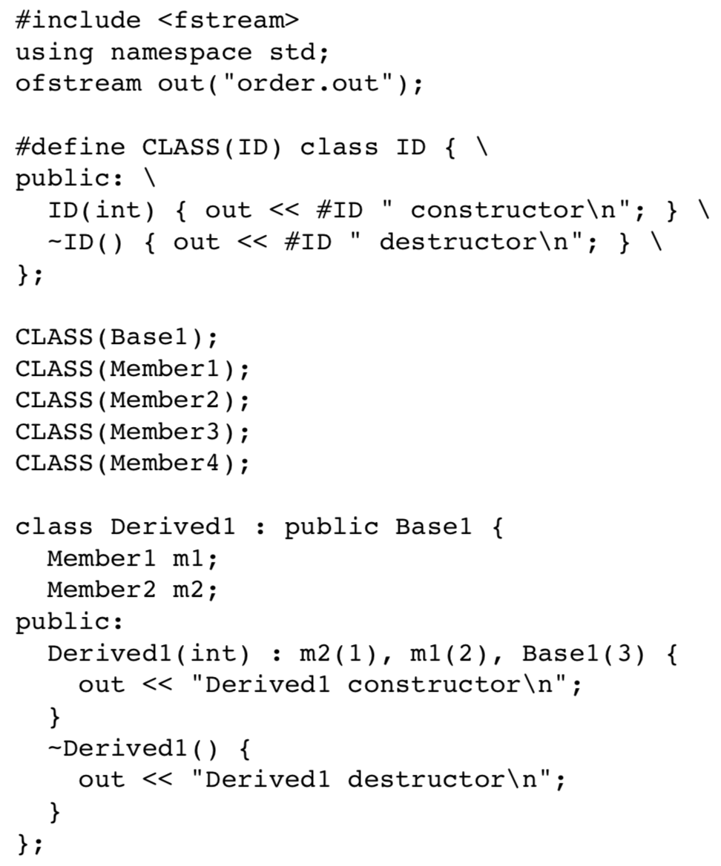

Slide 41
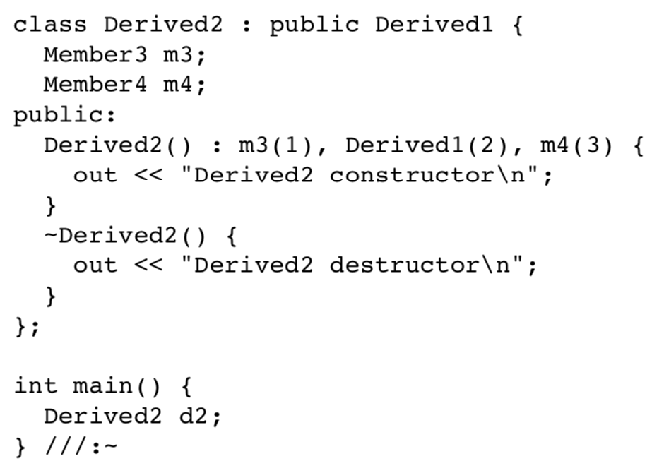

Slide 42
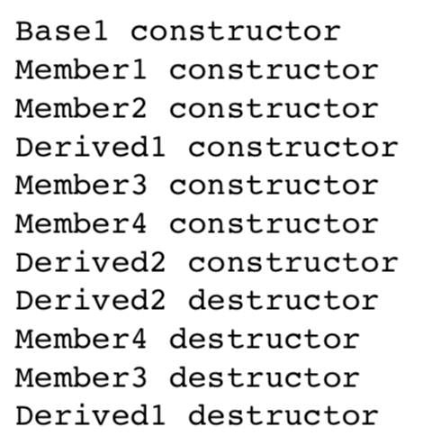
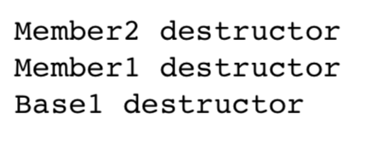
How the destructors are are called is opposite of how constructors are called

Slide 44
Protected and Private Inheritance
New inheritance "forms"
Both are rarely used
Protected inheritance: class SalariedEmployee : protected Employee {…}
Public members in base class become protected in derived class
Private inheritance: class SalariedEmployee : private Employee {…}
All members in base class become private in derived class

Slide 45
Protected and Private Inheritance
Private: can only be used by name in definitions of member functions and friends
Hidden: Cannot be accessed by name in the derived class

Slide 46
Protected and Private Inheritance

Slide 47
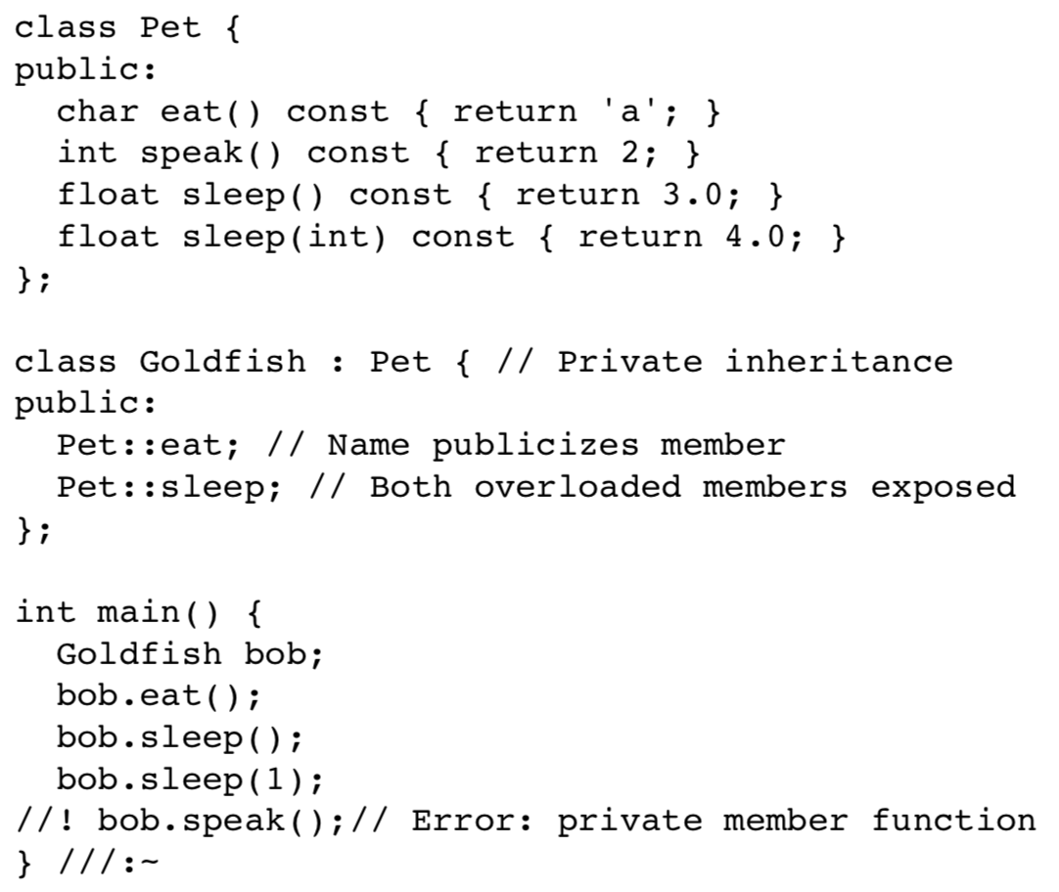
Protected and Private Inheritance

Slide 48
Multiple Inheritance
Derived class can have more than one base class!
Syntax just includes all base classes separated by commas: class derivedMulti : public base1, base2 {…}
Possibilities for ambiguity are endless!
Dangerous undertaking!
Some believe should never be used
Certainly should only be used be experienced programmers!

Slide 50
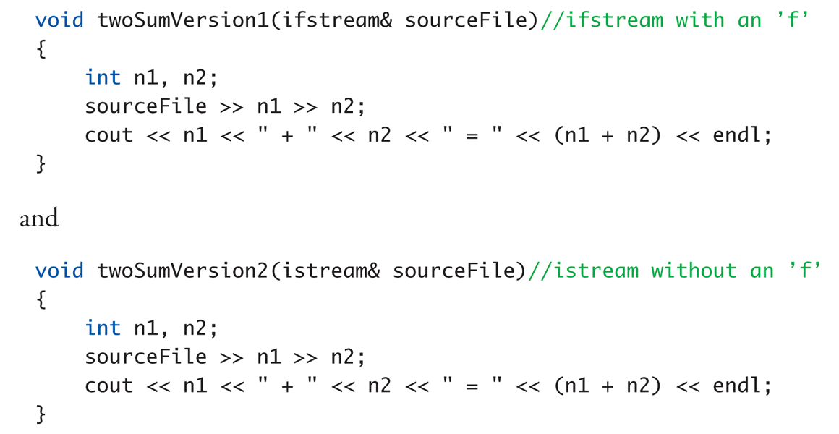
Upcasting
Recall:

Slide 51
Upcasting Example Calls
Considering previous functions:
twoSumVersion1(fileIn); // Legal!
twoSumVersion1(cin); // ILLEGAL!
Because cin is not of type ifstream!
twoSumVersion2(fileIn); // Legal!
twoSumVersion2(cin); // Legal!
More versatile
istream parameter accepts both objects

Slide 52

Upcasting
Inheritance:
Inherited member function for the new class
Relationship between the new and the base class
The new class is a type of the existing class

Slide 53
Upcasting
It is always safe (derived class → base class)
Example: design operator “<<“ for pokemon
class pokemon{ void attack(); };
class firePokemon: public pokemon{
void attack();
}
ostream & operator<< (ostream &, pokemon);

Slide 54
Pointer Upcasting
A simple assignment to a pointer or reference
firePokemon a; pokemon *p = &a; // Upcast pokemon &r = a; // Upcast

Slide 55
Pointer Upcasting
A Crisis??
firePokemon a; pokemon *p = &a; pokemon &r = a;
p->attack(); r.attack();
Cannot know that p and r actually points to a firePokemon object

Slide 56
Pointer Upcasting
A Crisis??
firePokemon a; pokemon *p = &a; pokemon &r = a;
p->attack(); r.attack();
Cannot know that p and r actually points to a firePokemon object → Polymorphism (next chapter)

Slide 58
Summary 1
Inheritance provides code reuse
Allows one class to "derive" from another, adding features
Derived class objects inherit members of base class
And may add members
Private member variables in base class cannot be accessed "by name" in derived
Private member functions are not inherited

Slide 59
Summary 2
Can redefine inherited member functions
To perform differently in derived class
Protected members in base class:
Can be accessed "by name" in derived class member functions
Overloaded assignment operator not inherited
But can be invoked from derived class
Constructors are not inherited
Are invoked from derived class’s constructor

